Slide 1
CTO Community Working Model
IT Leadership Forum – October 4, 2023
Michael Vormittag, Adrijana Music

Slide 2




Executive Summary
Information
Discussion
Decision
Background of the Treatment
There are currently Communities in the IT that work in a distributed fashion on products, projects or initiatives. One of the main challenges is the lack of commitment. With this model and your support we want to create commitment and accountability for Communities.
Purpose & Discussion
Together with you we want to break the silos and empower already motivated employees to feel supported to work in a distributed model
Recommendation / Next Steps
Who/Unit
Date
We will approach you via email for the assignment of new (~1 person per ITX) and empowerment of existing Community members in AI, FOSS, CONNECT UNLOCK DRIVE and Agile
We will work on the goals with the Sponsors
We will re-visit the model and results in IT-LSM in about 6 Months

Slide 3

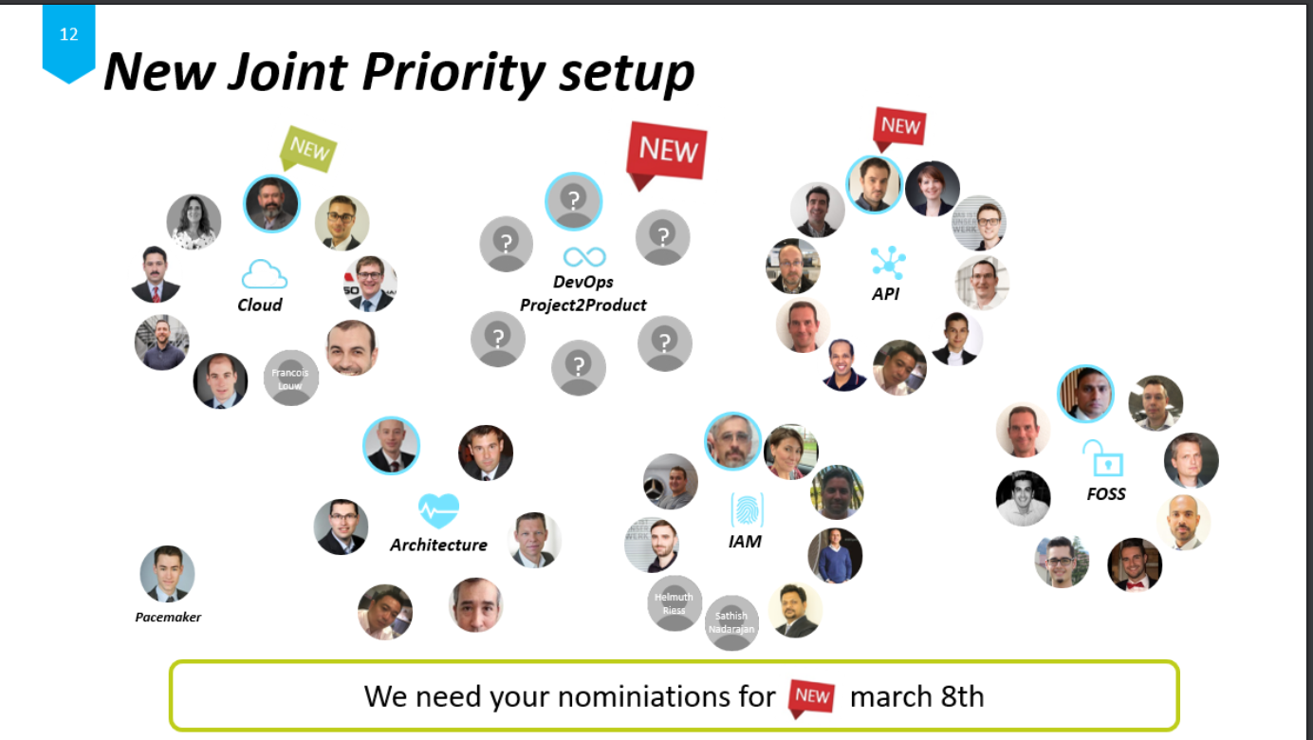
From initial set-up of communities we have now a diverse set of distributed virtual teams with different maturity
API
Unite Cloud
CUD
EA
FOSS
…
Agile
AI

Slide 4

We are already creating value but believe we can use the learnings to professionalize the model
Enterprise Architecture
Agile
CUD
AI
No accountability and commitment
People moved away from Roles
Sponsorship not executed
Unclear roles & responsibilities
No Goals
Wrongly assigned /inherited people
High Sponsor Engagement (Thomas steering and committing budget)
Defined Lead
Defined Goals
Very high intrinsic Motivation
Defined Lead
Defined Goals
High Sponsor Engagement (By the fact its for Marcus ☺ )
Defined Lead
L1 Support
Defined Goals
High Sponsor Engagement (Jonas active in “working groups”)
High intrinsic Motivation
Alignment sometimes missing

Slide 5
We want to enhance this model and propose a 3-step-approach for distributed collaboration
CoE
NEW!
CTO* Community
Decentral Team with formal structure
Clear responsibilities and goals
Close support and interaction with Group Architecture Board
“Biggest decentral topics”
Informal Community
Intermediate step to more formal CoE
Lean approach but includes goals and accountability
Details follow on next slide ☺
People who want to exchange on a topic loosely
There is value in this already!
*Open for nameing

Slide 6
In order to enhance the value of our communities we re-ignite them with a new level of professionalism*
Assigned Member
Goals and Sponsor commitment
Intrinsic Motivation
We want to make it official (again)
We want to give our volunteers the leadership backing they deserve (and need)
We want to strengthen the Sponsor role
We want to bring more accountability to it
We want to start a clear goal-process with sponsor and community
We want to use the opportunity to engage the people in their <3 topics
We want to make it ideally voluntarily but empowered by a mandate (and then part of the job)
This is still less formal than a CoE but holds already enough value. If a bigger organization (e.g. CoE) is required the transition can be made easily!
*in case the topic requires it!

Slide 7
Recommendation
Recommendation / Acknowledgment / Next Steps
Who /Unit
Target date
Y
N
We will approach you via email for the assignment of new (~1 person per ITX for e.g. AI) and empowerment of existing Community members in AI, FOSS, CONNECT UNCLOCK DRIVE and Agile We only need motivated volunteers – don’t assign for the sake of assigning ☺ We will re-visit th topic and results in IT-LSM in about 6 MonthWe will re-visi
We will work on the goals with the Sponsors
We will re-visit the model and results in IT-LSM in about 6 Months

Slide 8
Backup

